Slide 1

COS112 - PROGRAMMING FUNDAMENTALS I
Introduction to Programming with C++
Week 1: The Building Blocks of Software
Lecturer: Abdulaziz Oday

Slide 2
Module 01
What is Programming?
Definition 1: Programming is the process of creating a set of instructions that tells a computer how to perform a task. It is the bridge between human logic and machine execution.

Slide 3
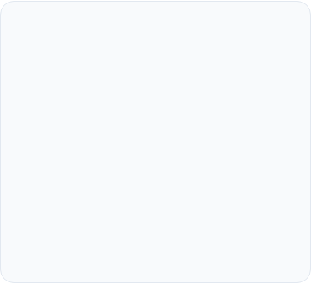
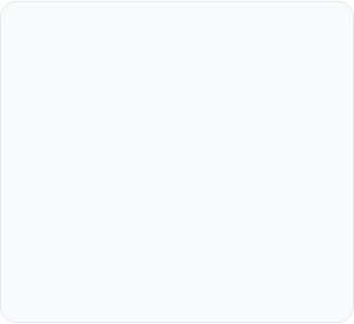




The Programming Concept
The Idea
The Logic
The Code
Identify a problem you want to solve, like calculating a grade or converting currency.
Create a step-by-step set of instructions (an Algorithm) to solve the problem.
Translate your instructions into a language the computer understands (like C++).

Slide 4

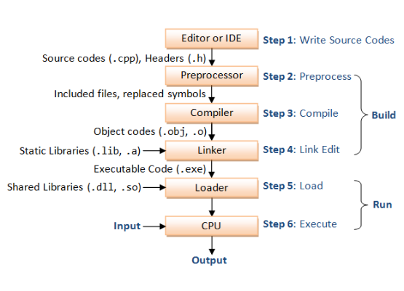
How C++ Works (Compilers)
Definition 2: Compiler is a software tool that translates the human-readable C++ source code into low-level machine code that a computer's processor can directly understand and execute
Translation Process
Computers do not understand English. They only understand "Machine Language" (0s and 1s).
Source Code: The text file you write (.cpp).
Compiler: A tool that translates your text into machine code.
Executable: The final program (.exe) that runs.

Slide 5
Module 02
Anatomy of a Program
Breaking down the "Boilerplate" code every program needs.

Slide 6
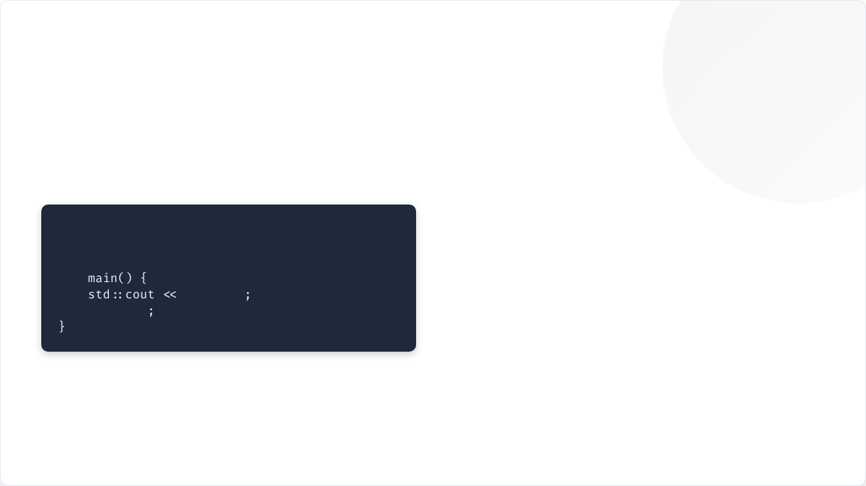
Basic C++ Syntax
Definition 3: Syntax is the set of rules that defines how a C++ program is written and compiled
#include: Tells the computer to use a library (like a toolbox).
// Basic Program Template
#include <iostream>
: The library for Input and Output.
int
"Hello!"
main(): The starting point where the program begins.
return
0
std::cout: Stands for "Character Output" (the screen).

Slide 7
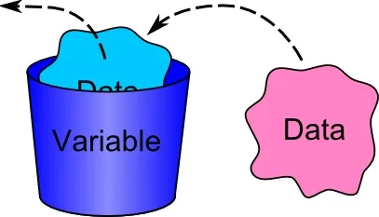

Variables: Storing Data
int / double
string
bool
Whole numbers (int) and Decimal numbers (double).
Text, names, or messages (e.g., "Ali").
True or False decisions (On/Off switches).

Slide 8
The Input / Output Flow
cin
cout
CHARACTER INPUT
CHARACTER OUTPUT
Data flows FROM the keyboard TO the variable.
Data flows FROM the variable TO the screen.

Slide 9
Basic Math Operators
Standard Math
The Modulo (%)
+ (Addition) - (Subtraction) * (Multiplication) / (Division)
The % operator gives you the remainder of a division. Example: 10 % 3 = 1.

Slide 10

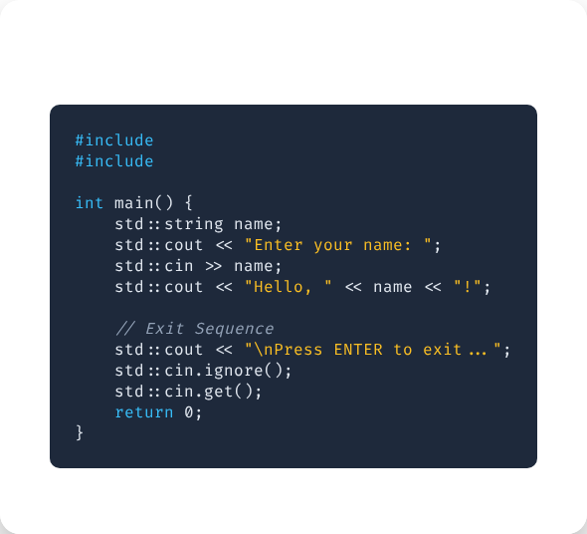
Lab: Interactive Greeting

Slide 11
Lab: Temperature Converter
Step | Action | C++ Example
1 | Create Variable | double celsius;
2 | Get User Input | cin >> celsius;
3 | Apply Formula | double fahr = (cels * 9/5) + 32;
4 | Display Result | cout << fahr;

Slide 12

Summary & Questions
Programming is about logic and translation.
Resources & Contact:
Email: abdulaziz.oday.dahab@gmail.com

